Slide 1





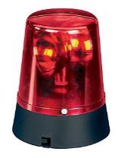



Department of Physics and Astronomy
Site Induction
Schuster and Alan Turing
The Department’s facilities include laboratories, clean rooms and workshops where hazards may be present, including: cryogenic liquids, oxygen depleted areas, compressed gases, hazardous chemicals, biological agents, high voltage, strong magnetic fields, overhead cranes, lasers and radiation sources etc.
Please follow all instructions: do not touch any of the equipment unless authorised to do so.
Fire exits are signposted throughout the Department: fire alarm tests occur at different times in the different buildings (see below). This will sound for ~ 30 seconds. If you hear an alarm for longer at this time or any other time, please leave via the fire exits and move to the nearest assembly point. There are also alarms for carbon dioxide build-up and oxygen depletion which is a continuous alarm with blue or red flashing beacons. Please vacate these areas immediately, never enter an area that is alarming.
Asphyxiation
Laser Radiation
Toxic Materials
Biological
Compressed
Gases

Slide 2



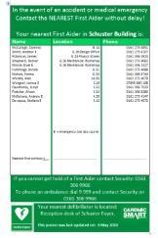
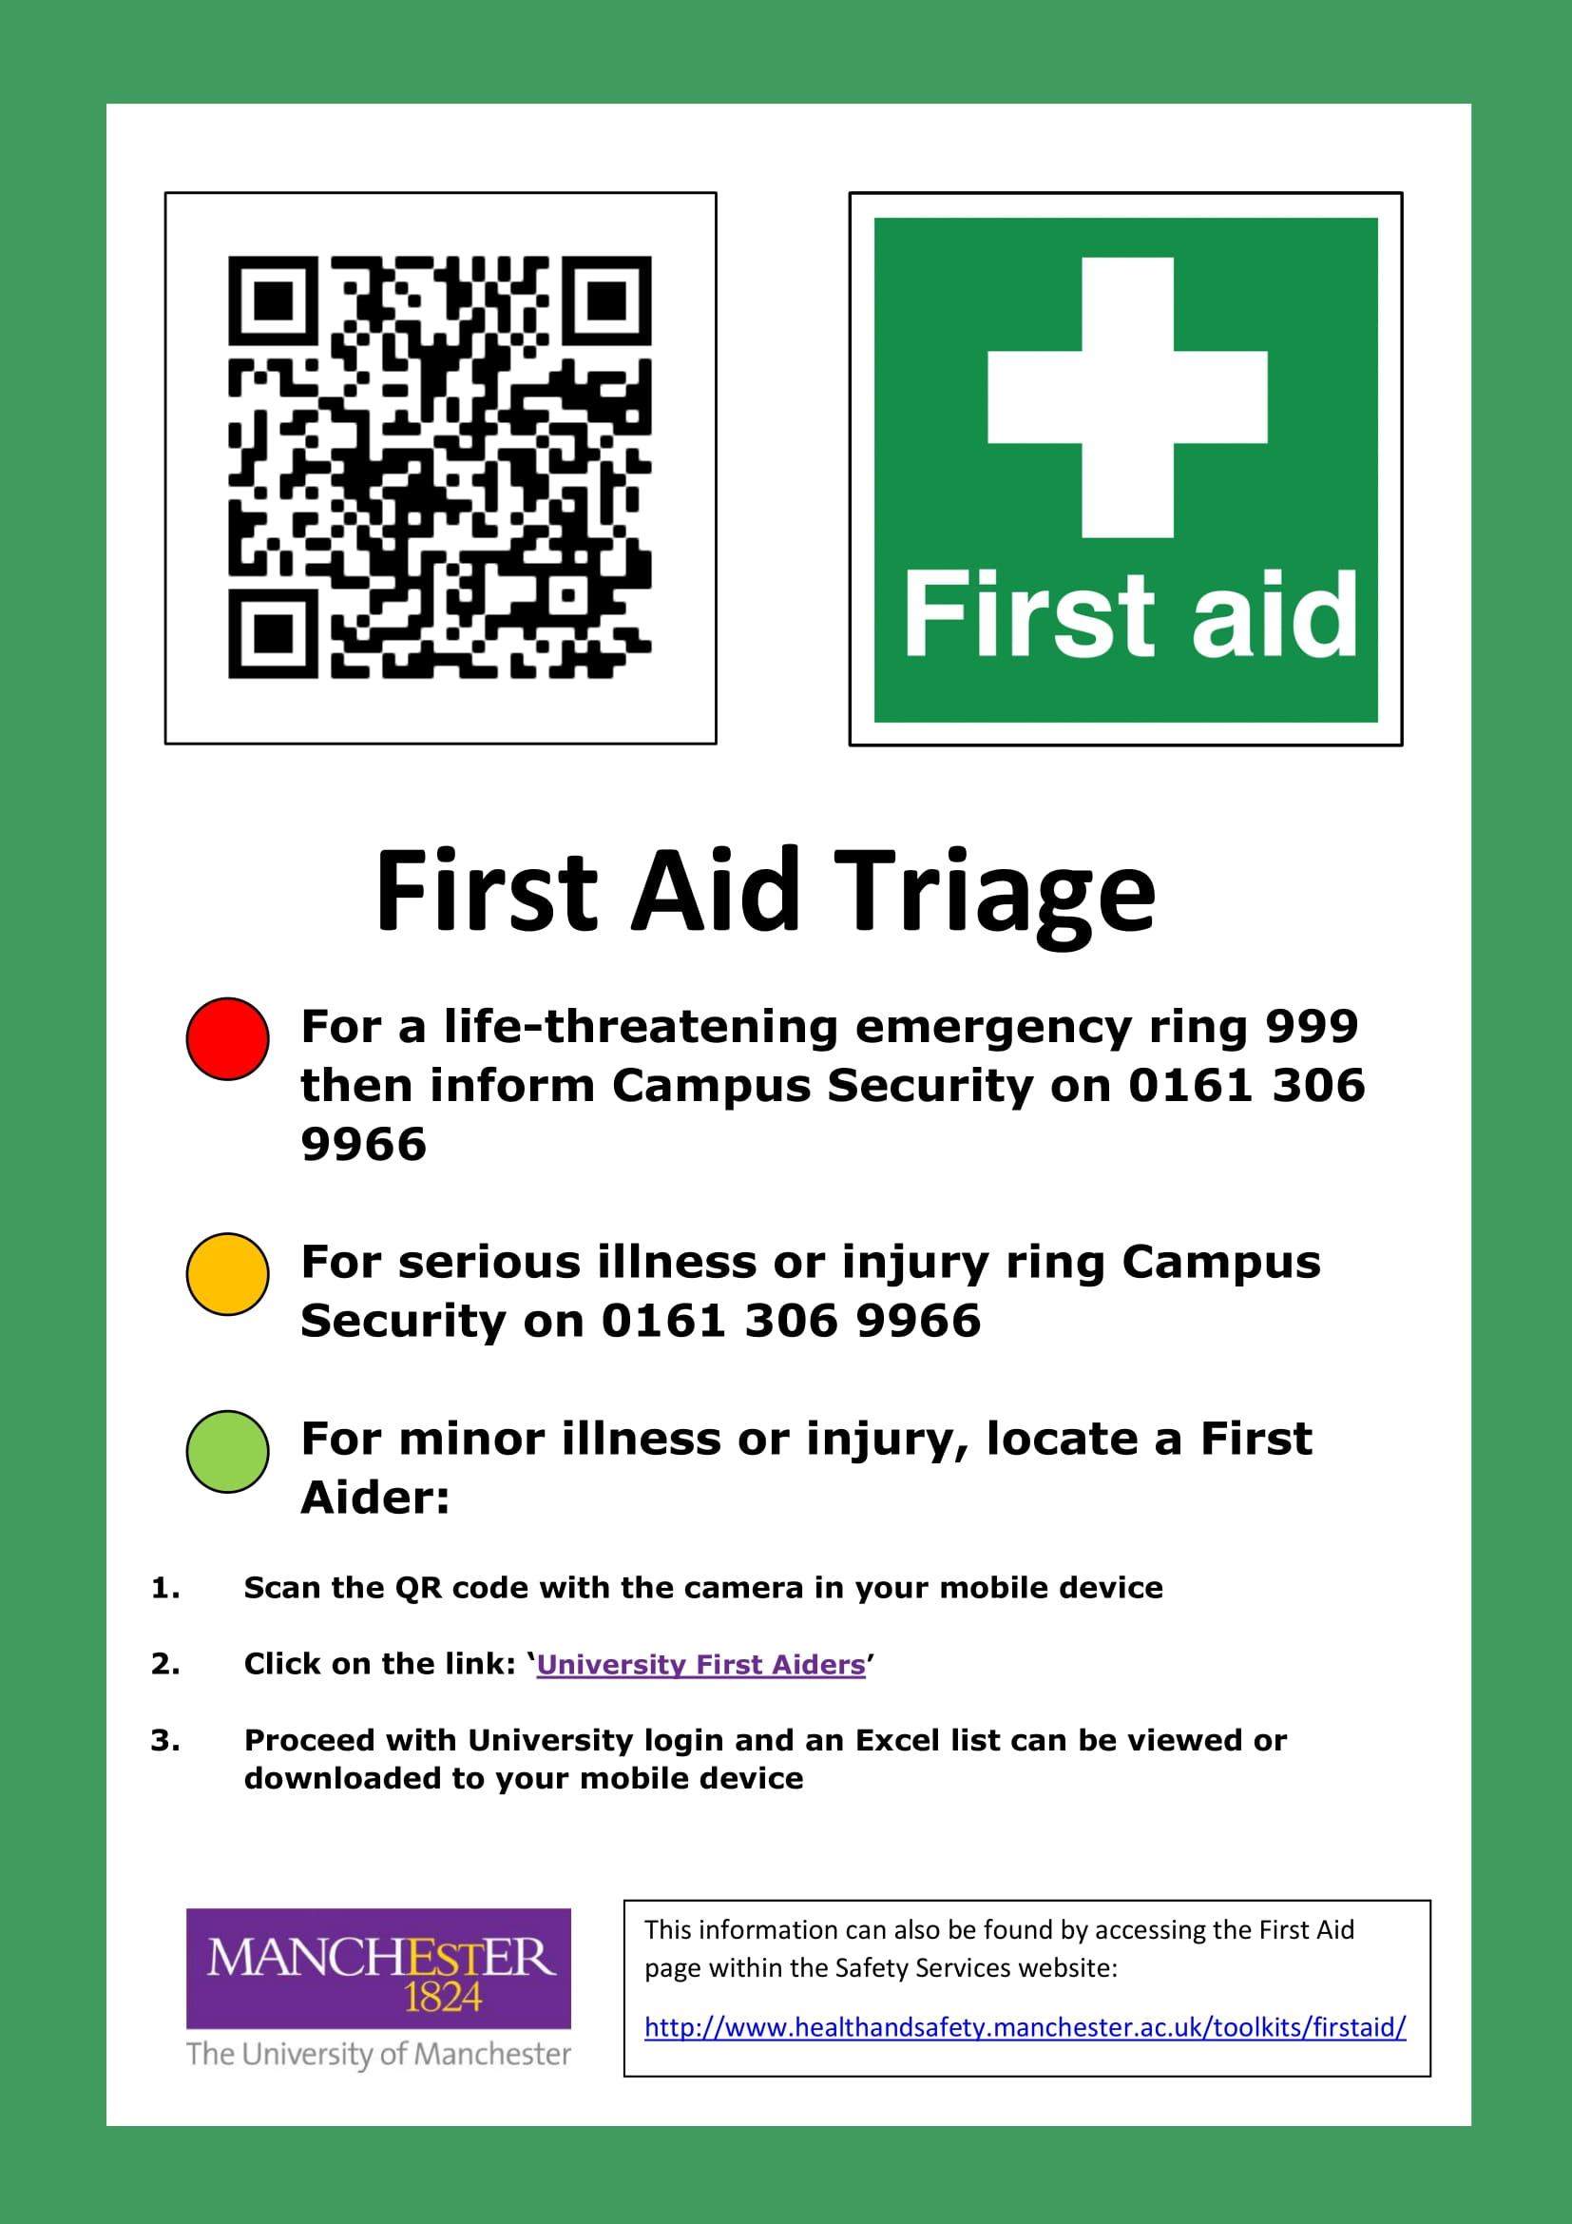
Department of Physics and Astronomy
Site Induction
Schuster and Alan Turing
PPE must be worn inside laboratory, clean room and workshop areas: please see the door signage for relevant hazards that might be encountered and the appropriate PPE needed to protect you . The correct PPE will be issued to you for the duration of your stay. Before leaving a laboratory area, please wash your hands. No food or drink is permitted in any laboratory, clean room or workshop.
Report Accidents & Incidents:
Emergency : in the event of an emergency, activate the fire call point if required to initiate an evacuation and call University Security Service on 0161 306 9966. Tell them where you are and they will coordinate the emergency services if required. Exit calmly and immediately by the nearest safe route to the designated Assembly Points.
-----------------------------------------------------------------------------------------------------------------------------------------------------------DECLARATION: I confirm that I have read this information and that I understand the hazards and risks involved and will follow all of the safety procedures stated.
NAME:……………………………………….....................................................................................DATE:………………
SIGNATURE:………………………………………………………………………………………………………………………………….............
Lab Coat Must
Be Worn
Protective Gloves Must Be Worn
Eye Protection Must Be Worn
First aiders: available 8 am - 5 pm, their names are on the green first aid notices posted prominently throughout the buildings, these are in all labs and corridors. Out of hours, University Security can be called to provide first aid: 0161 306 9966.
Role | Name | Building | Room | Telephone
School Safety Advisor | Nicola Hutchings | Schuster | G.51 | 0161 275 4088
Technical Operations Manager | Hayley Markham | Schuster | 2.55 | 07741 171 876
Senior Buildings Technician | Julie Duckworth | Schuster | 2.55 | 07917 984 677
Building Manager | Alan Wardle | Schuster | 1A.05 | 0161 275 4079

